Slide 1
MUNCH
Progress Report #4
Gabriel Soares & Gabriel Mendonca

Slide 2
Table of Contents
01
02
03
04
05
Timeline
Updates
Frontend
Search Reviews
Questions?
Notes:
Soares

Slide 3
01
Timeline
Notes:
Soares

Slide 4
Project Timeline
Week 1-2 (Feb 20 - Mar 5)
Finalize Restaurant Search V1.
Setup GitHub and Trello for tasks.
Finalize entire project concept and decide what features the app will have + tech stack to build.
Week 7-8 (Apr 3 - Apr 16)
Finalize Llama search V2 (Review dataset search for better ranking).
Prototype of the overall app for testing.
Integrate Backend and Frontend
Week 3-4 (Mar 6 - Mar 19)
UI/UX Design: Draft initial Figma designs and user flow wireframes.
Optimize restaurant search V1 - Expand filtering capabilities and polish LLM response structure.
Week 9 (Apr 17 - Apr 23)
Finalize frontend development.
Conduct intense testings on the search feature and polish the algorithm/add missing features.
Polish UI and UX designs.
Week 5-6 (Mar 20 - Apr 2)
Finalize development of backend infrastructure.
User authentication implemented.
Basic frontend version working.
Figure out data storing and app hosting
Week 10-11 (Apr 24 - May 1)
Fully ready V1 of the app.
Address any remaining issues or bugs.
Present final project & collect feedback for improvements.
Notes:
Soares

Slide 5
02
Updates: Monetization, Data and User Profile

Slide 6

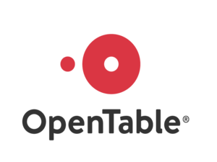
Monetization Strategy
User-Centric Approach:
Free unlimited access to AI search and recommendations
Idea for user rewards program for engagement such as, points redeemable for dining discounts
Data Analytics for Restaurants:
Basic Analytics (Free): Snapshot reports on user engagement with restaurant profiles.
Advanced Analytics ($15/month): In-depth insights into consumer behavior and preferences
Restaurant Owner Subscriptions:
Basic (Free):AI search, access reviews
Pro ($29/month): Enhanced search profile, monthly analytics report
Premier ($49/month): Priority listing, targeted keyword campaigns
Marketing and Growth:
Initial user base target: 10,000 users in Year 1
Restaurant subscription target: 100 in Year 1, with 30% annual growth
Revenue Opportunities:
Pay-Per-Click Ads: Starting at $0.30/clic
Keyword Feature Ads: Starting at $25/month
Reservation Fee: $0.50 per reservation
Budget-Friendly Growth Goals:
User base growth target: 10,000 to 20,000 in the first year
Revenue goals: $1000 to $2000 monthly, aiming for a 25% increase year-over-year

Slide 7


Servers
AWS Free Tier & Cost Explorer:
Our platform begins with a cost-saving AWS free tier; afterwards, it's a straightforward pay-for-what-you-use model.
Cost predictions at $0.01 per API request
Hourly Cost Insights:
For precise spending, AWS tracks every hour of service like EC2 use, at a tiny fraction of a cent per record
EC2 provides resizable computing capacity in the cloud, allowing you to use virtual servers to run applications.
Cost prediction at $0.00000033 per record
No Hidden Costs:
No need for your own servers or upfront fees, and absolutely no extra licensing costs. Even with round-the-clock use, EC2's detailed billing adds $0.003 to your monthly bill.

Slide 8



User Profile
Target Customer Profile & Acquisition Tactics
Initial User Analysis & Product Improvement
Interests: Environmental sustainability, health, food experiences
Demographics: 25-45 age range, middle-upper income, urban dwellers
Behavior: Tech-savvy, prefers organic/non-GMO/farm-to-table, influenced by social media and online reviews
In-app analytics: User time, click rates, feature usage
Feedback methods: Online surveys, in-app feedback, focus groups
Personalization based on user preferences and behavior
Use TikTok to create viral content and quickly attract several users through the platform.
Influencers might help us by sharing fun videos about us, getting more people engaged
We'll pick influencers who have a wide reach on users who often do restaurant searching.
Customize app features using analytics (e.g., vegan options, simplified UI)
Continuously improve based on user feedback and data analysis

Slide 9
03
Frontend

Slide 10
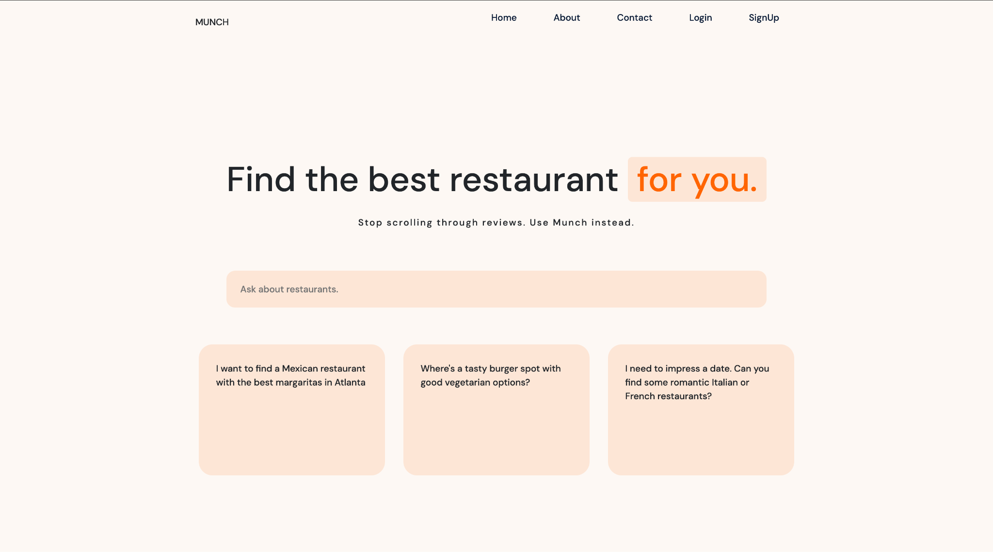

Slide 11
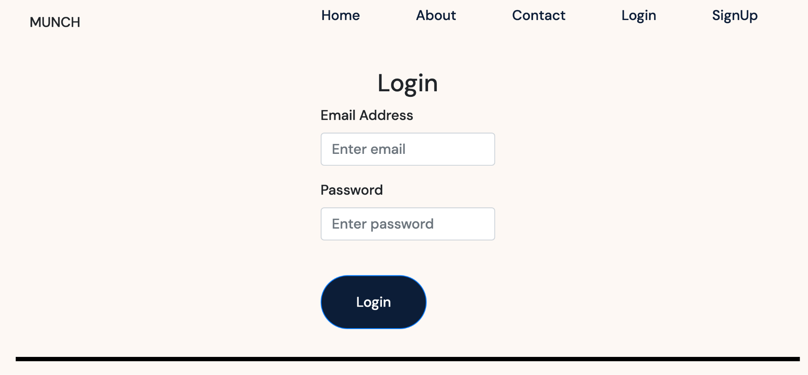
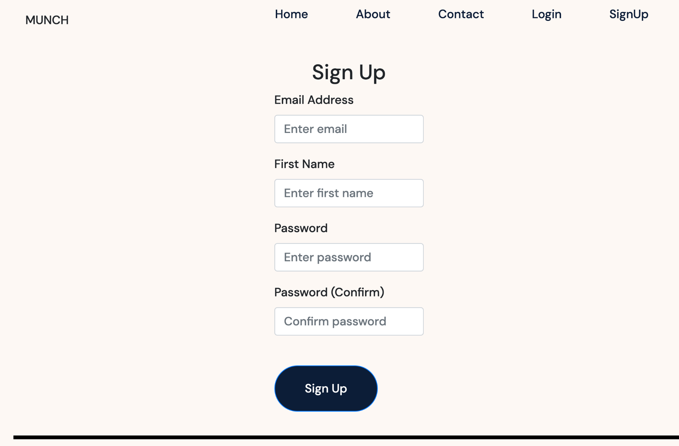
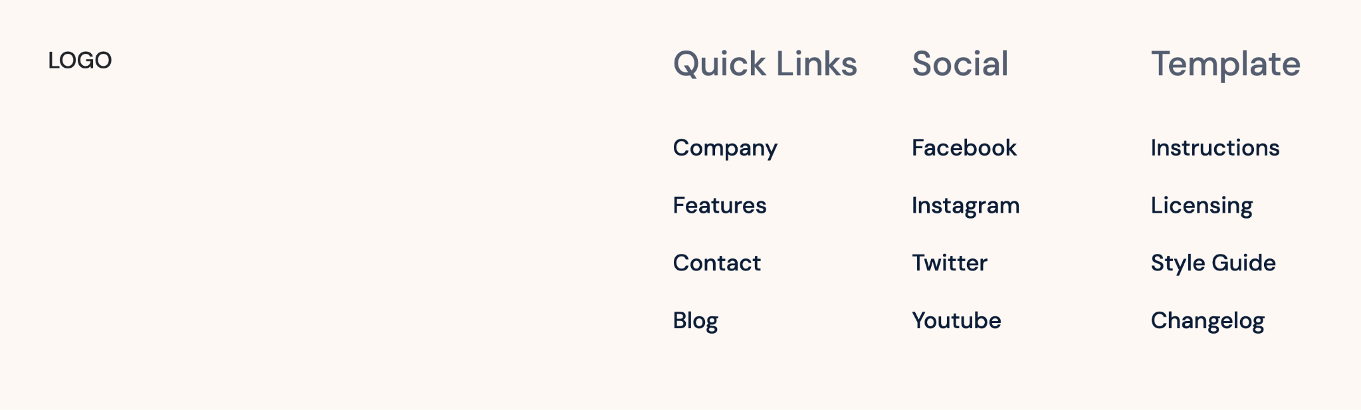
Authentication Pages

Slide 12
04
Search Reviews

Slide 13
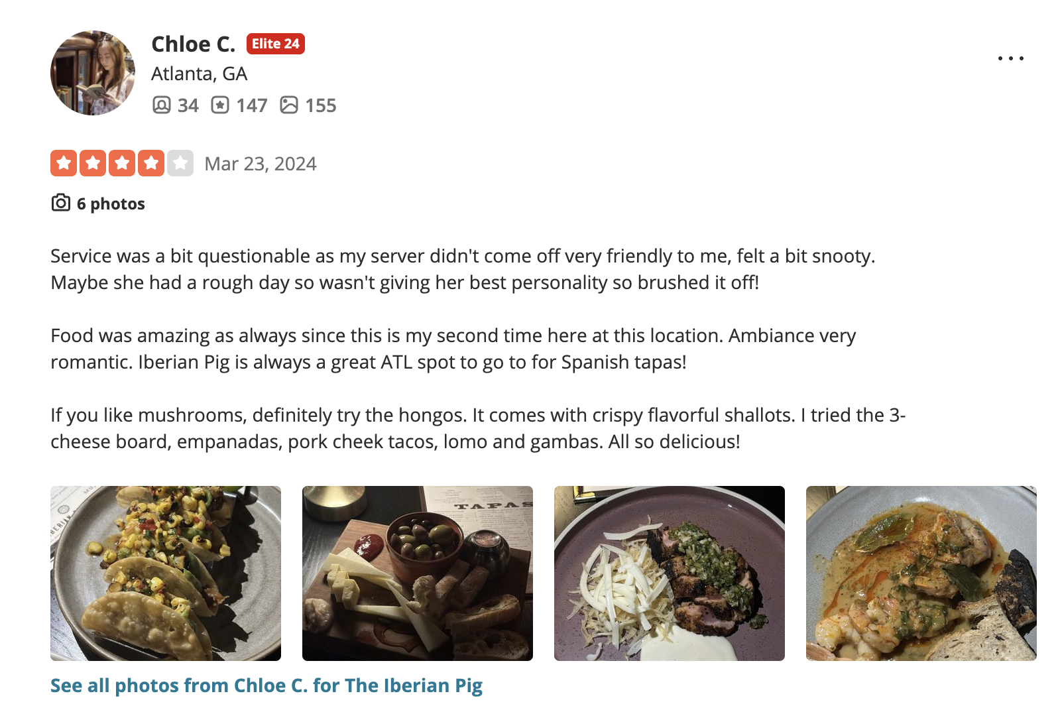
Problem With Text Reviews

Slide 14

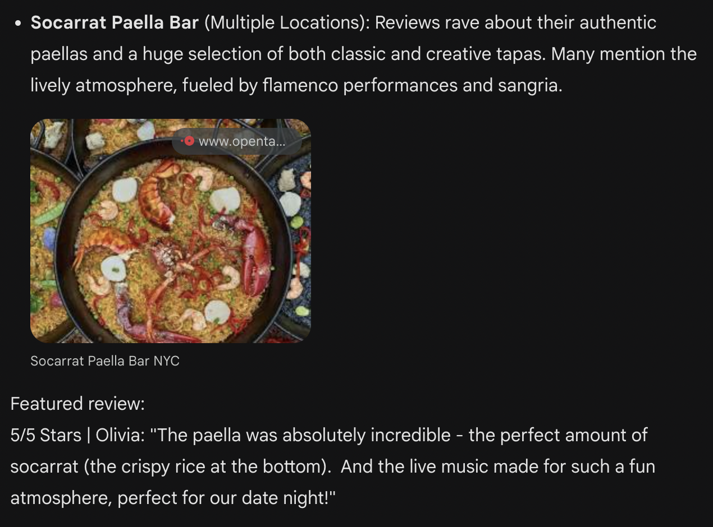
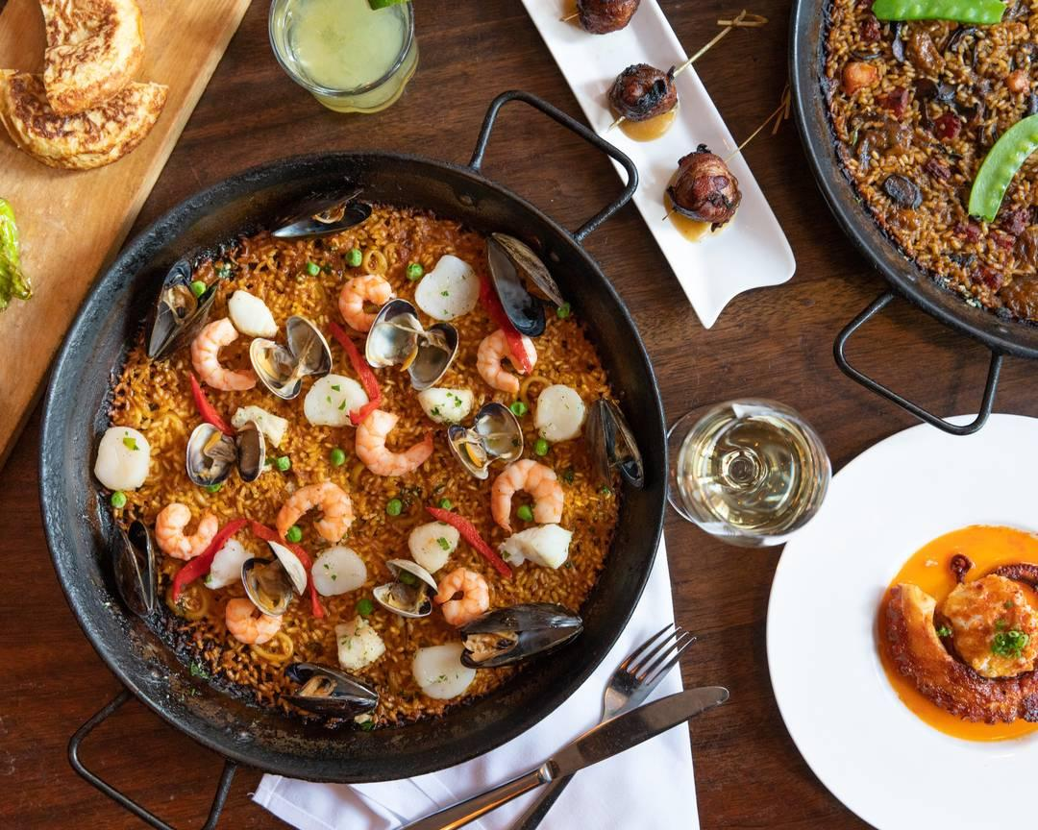
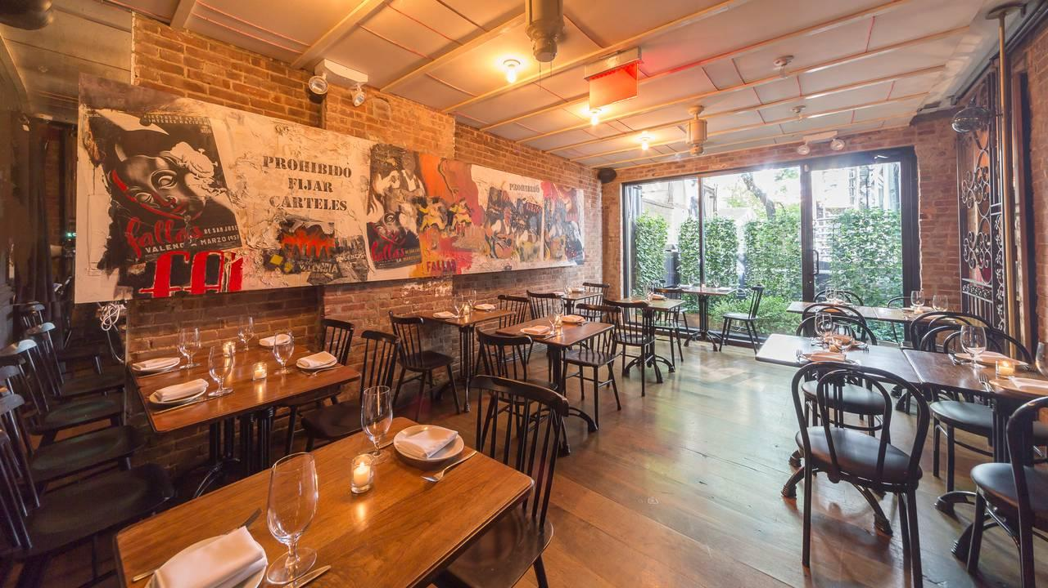
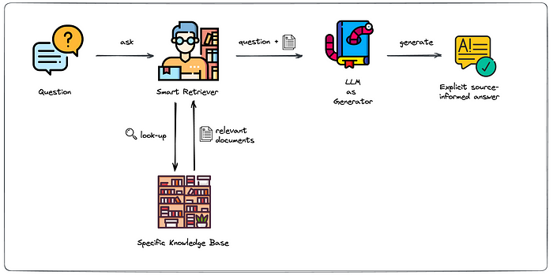
Retrieval Augmented Generation (RAG)
Step 1: Embed and index our entire restaurant review dataset.
Step 3: Our RAG pipeline then sends all the relevant restaurant/review information and rankings back to our GPT4 agent, and he crafts the final response for the user, based on that data.
Step 2: After user sends restaurant search query, smart retriever compares it with all restaurant reviews to find similarity score between them.

Slide 15
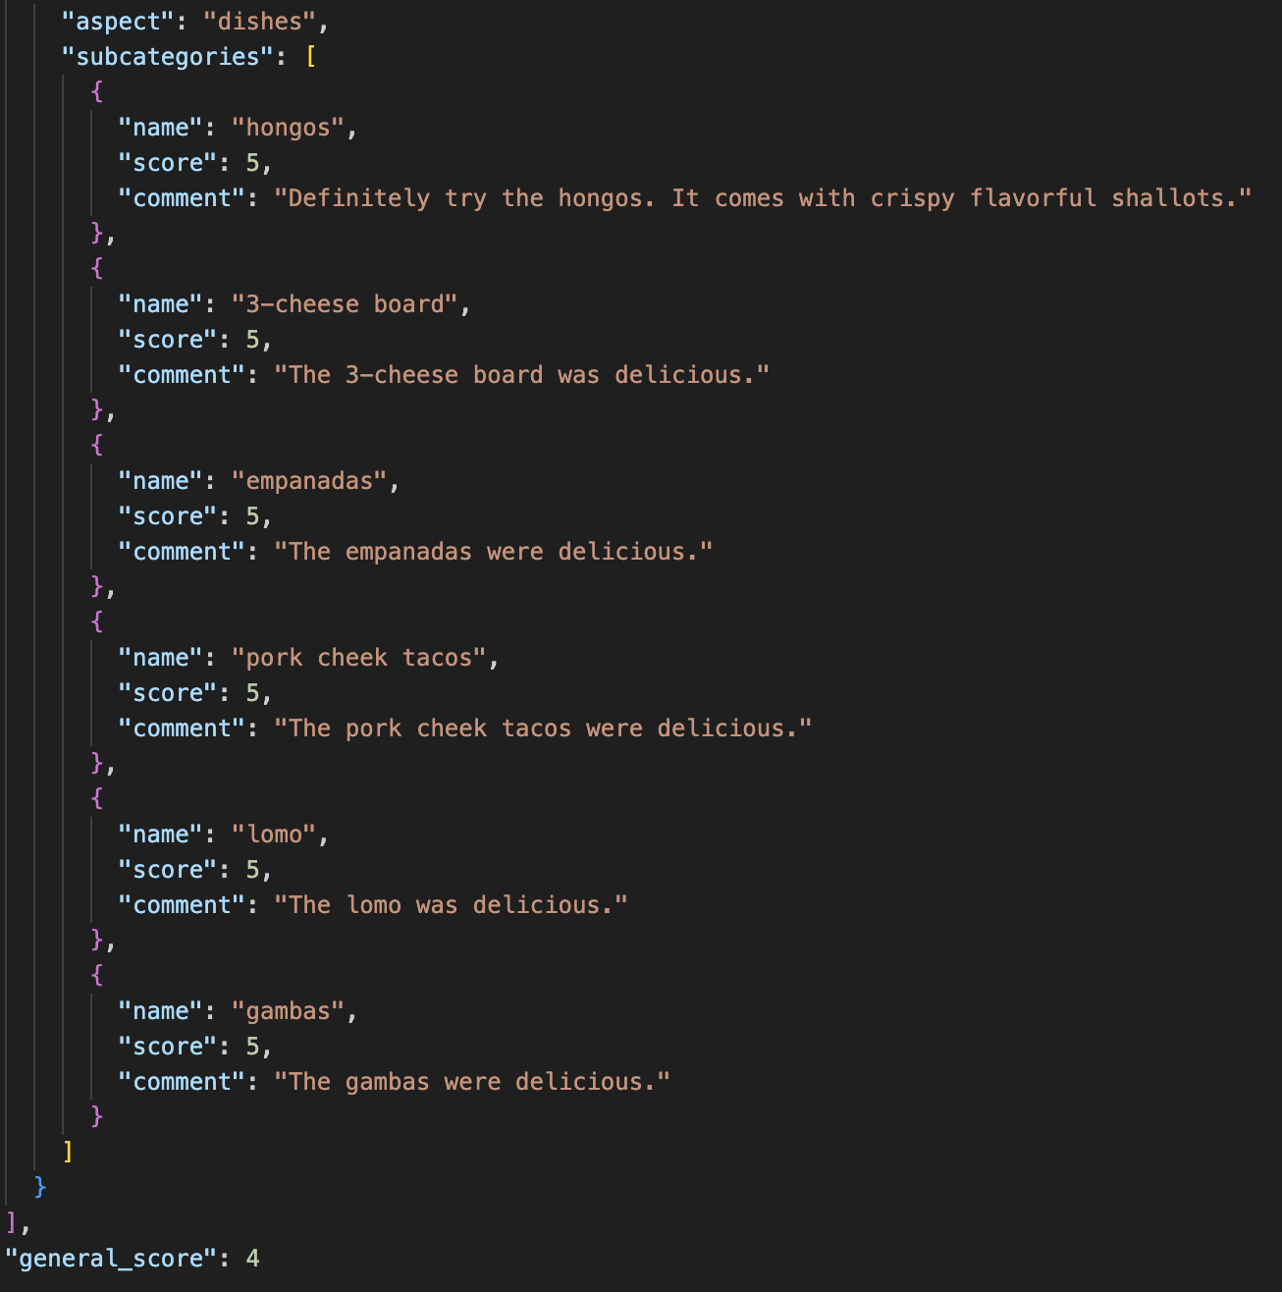
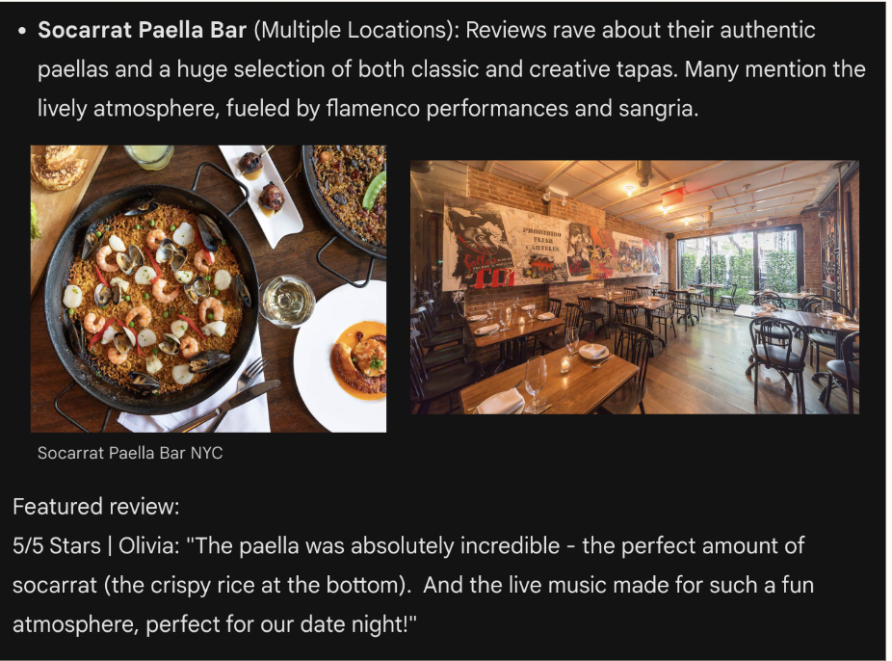
New! - LLM Assisted Dataset Enrichment (In Progress)
Step 1: Extract, score, and structure our entire restaurant review dataset, using GPT-3.5
Step 3: Our LLM pipeline then sends all the relevant restaurant/review information and rankings back to our GPT4 agent, and he crafts the final response for the user, based on that data.
Step 2: After user sends restaurant search query, it’s subjective features are identified and their respective scores on the enriched review dataset are used to re-rank the remaining restaurants that survived the first filtering cut.

Slide 16
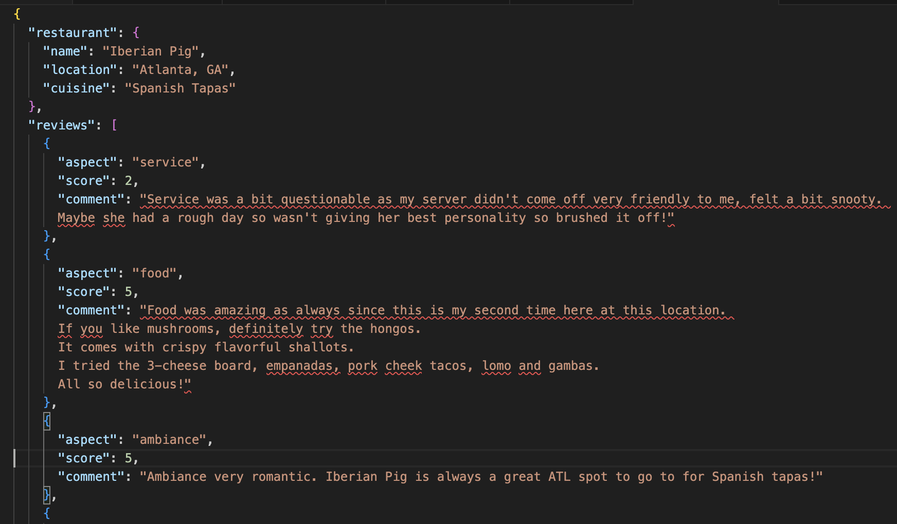

Slide 17



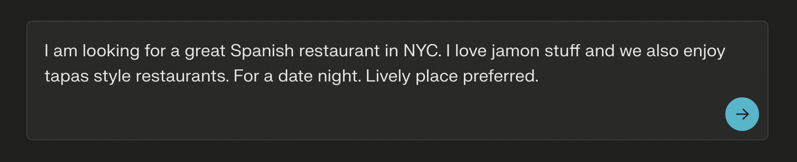

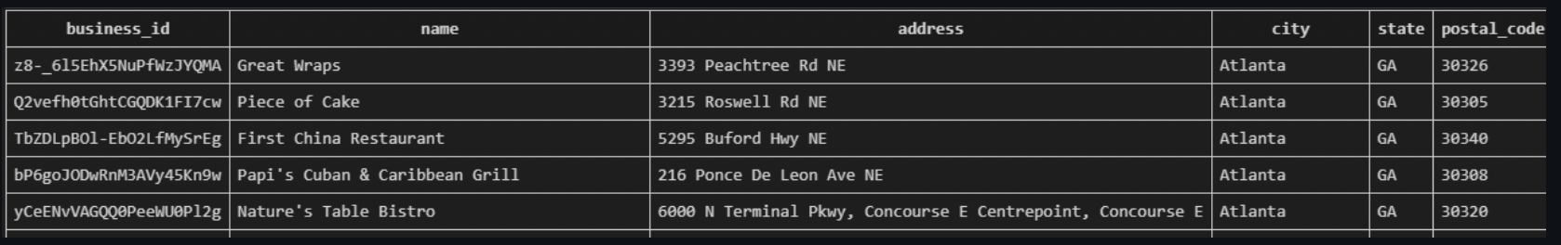
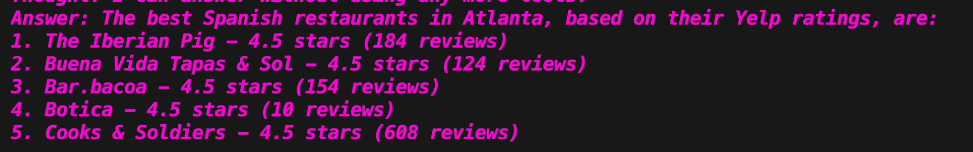
Database Filtering from Natural
Language Query (DONE!)
Step 1: Send to GPT4:
User’s query
Database schema
Special prompt
Step 2: GPT4 returns to the backend only the custom pandas code necessary to perform the filtering.
Step 3: Llama Index’s agent executes the code, filtering the dataset to only include Tapas Style Spanish restaurants in NYC, that have Jamon as a menu item.

Slide 18
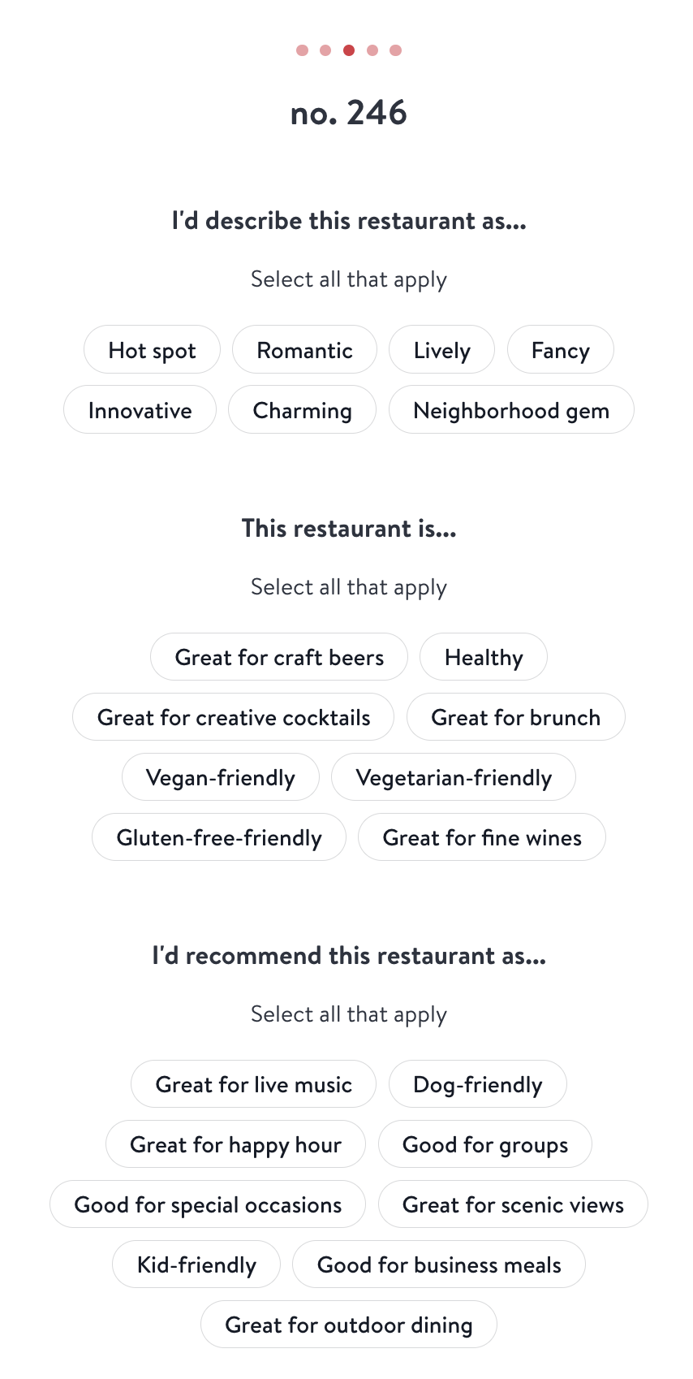
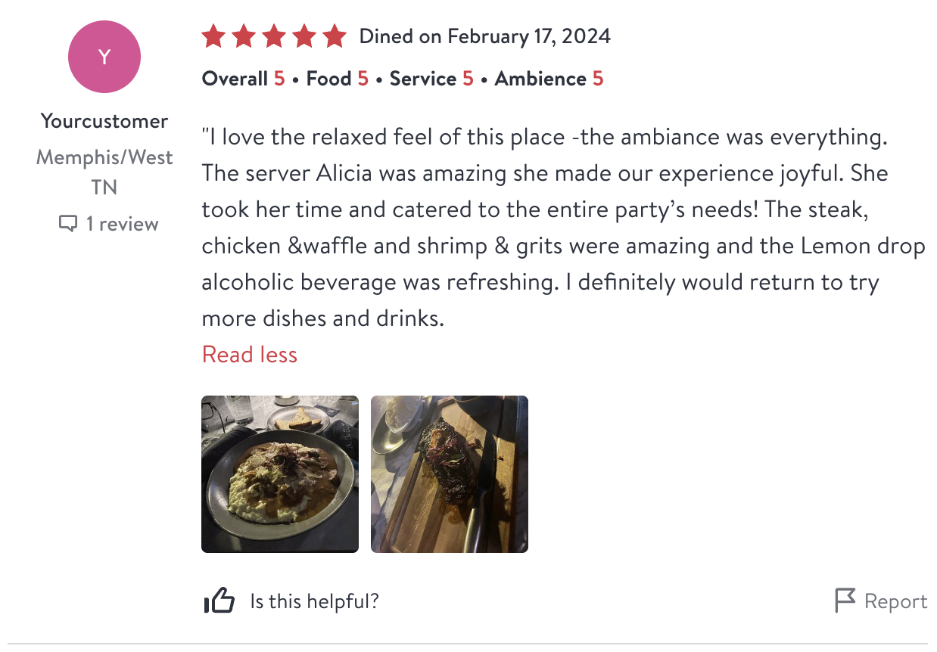
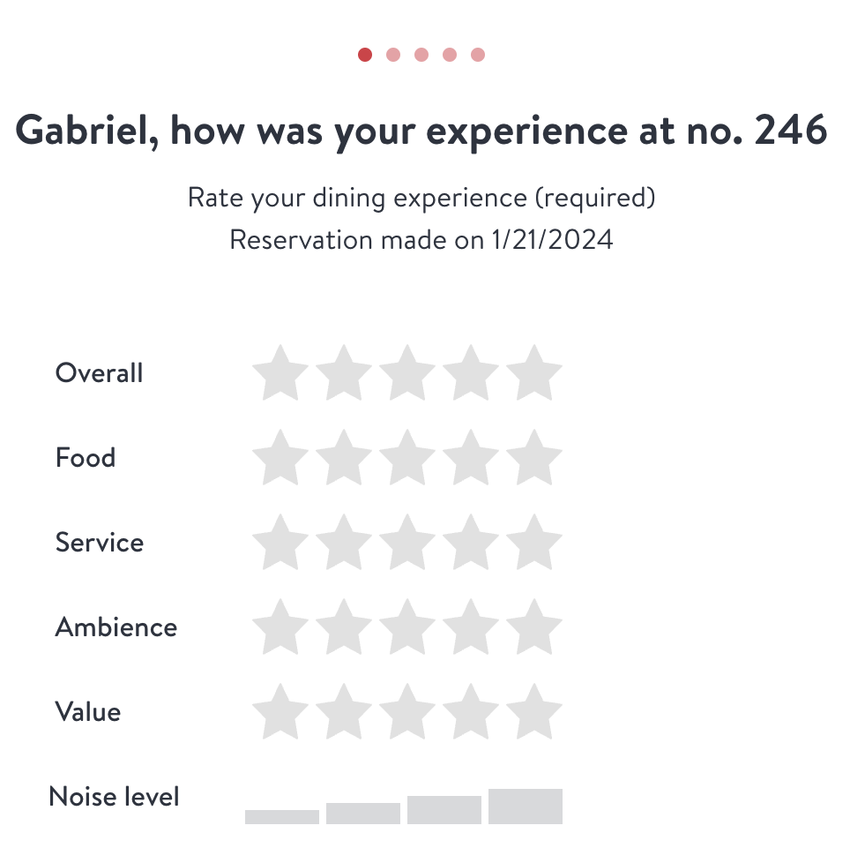

Slide 19
For Next Sprint:
01
02
03
Finish Search V2 (Using Reviews)
Display Results on Frontend
Comprehensive Solution for Dataset Problem

Slide 20
Thanks!
Questions?

